Slide 1
Computer Science 20
FLOW CHARTS

Slide 2
Planning our Solutions
As we deal with increasingly complex problems, the planning steps become very important in efficiently reaching a solution
Structured way to think through problem fully
Reduce time wasted if initial idea has an unseen flaw
Creates a ‘rough draft’ which can be followed once implementing the solution

Slide 3
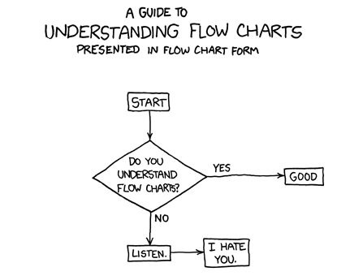
Flow Charts
One common planning process involves creating a flowchart, which diagrams the flow of execution in a proposed program.
www.xkcd.com

Slide 4
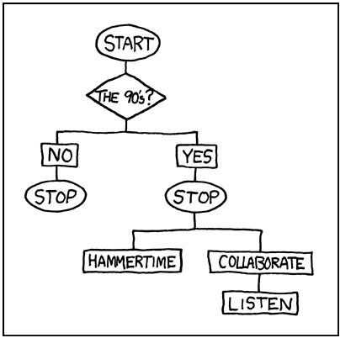
Common Shapes
Different shapes are used in flowcharts, each with a specific meaning. Looking at the following flowchart, try to identify what each may be used for:
www.xkcd.com

Slide 5
Common Shapes
Defines the start or end of a process.
Terminal
Rectangle shapes are used to represent an action that is performed. Ex: Add two values together.
Process

Slide 6
Common Shapes
Shows that a decision is necessary; typically a YES/NO question or a TRUE/FALSE test.
Decision
A process involving receiving data or displaying processed data. Eg: Ask user to enter a number, display result of calculation
Input/Output

Slide 7
Activity
PAIR PROGRAMMING
A common practice in industry is for developers to work in pairs.
“Two heads are better than one”
Increases problem-solving capabilities and design decisions
Improved morale and mentoring
Two main roles: The Driver and The Navigator
The driver is at the keyboard and does the typing
The navigator is following along and helping verbally to work through problem and spot potential issues.

Slide 8
Activity
Working in random pairs, you’ll try pair programming and flow charting.
STEP ONE:
With your partner, create a flowchart for a solution to the following problem:
Create a game that does the following:
generates a random number from 1 to 100
repeats the following until the user guesses the number
gets the user to guess the number
tells the user if the number is too high or too low
congratulates the user when they guess the correct number with a message such as "Way to go! You guessed the right number in 9 tries!"

Slide 9
Create a game that does the following:
generates a random number from 1 to 100
repeats the following until the user guesses the number
gets the user to guess the number
tells the user if the number is too high or too low
congratulates the user when they guess the correct number with a message such as "Way to go! You guessed the right number in 9 tries!"
Terminal
Decision
Input/Output
Process

